Slide 1
Keyframe Interpolation
… OF MD2M LIBRARY

Slide 2
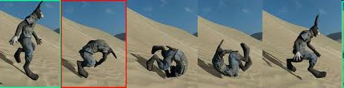
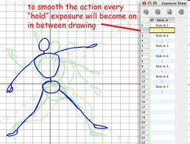
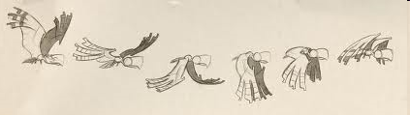
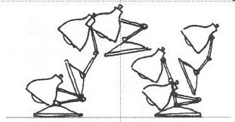
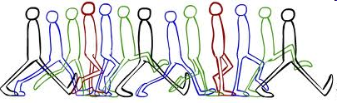
Keyframe & Inbetweening

Slide 3
Keyframe Interpolation₁
Periodic motion, with n keys, period T
  Each key contains the pose-defining parameters
At time t, subtract integer multiples of T (so that 0 ≤ t* < T)
Use t* to determine the interpolating keys
  the max i with t(i) < t*
Linearly interpolate key(i) and key(i+1)
Key1
t1
Key2
t2
Key3
t3
…
Keyn
tn
T

Slide 4
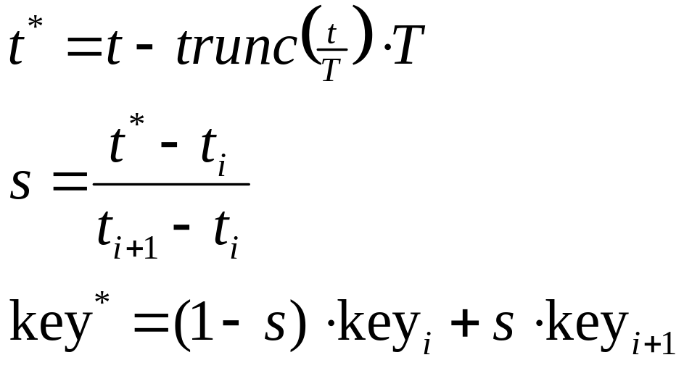
Keyframe Interpolation₂
Key1
t1
Key(i)
t(i)
Key(i+1)
t(i+1)
…
Keyn
tn
…
T

Slide 5

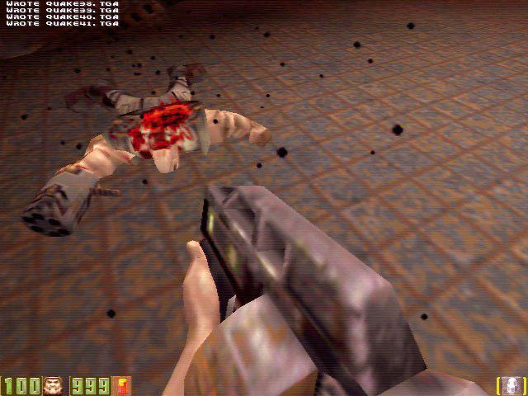
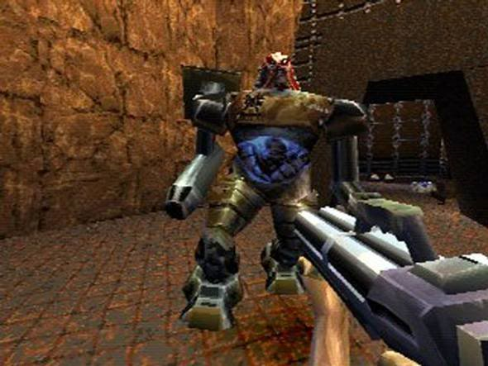
Quake II（雷神之錘II）
First-person shooter game by id software in 1997
Md2: the model format used by Quake II
Model archive: http://planetquake.gamespy.com/quake2/

Slide 6
High Level API
Use ReadMD2 or Load to read in a model & skin
t3DModel *MD2MReadMD2 (char* meshfile, char*skinfile);
  The top level loader; returns a pointer to t3DModel
void MD2MLoad (t3DModel*, char* meshfile, char* skinfile);
  Quake2 models order their triangles in CW fashion. Thus, the front-face culling is turned on
Find center and dimension based on first frame
void MD2MFindDimension (t3DModel*, float* center, float* size);
Keyframe interpolation
int MD2MInterpolate (t3DModel*);
  Called in display routine (increment frames based on Δt)
  Return 1 if pose is over

Slide 7
API (cont)
Animation Setting
void MD2MSetLoop (t3DModel*, GLboolean);
  GL_TRUE|GL_FALSE (at the end of cycle, staying at last frame by setting two interpolating frame at the last frame)
void MD2MSetAnimation (t3DModel*, int pose);
  Pose starts from 0 (usually STAND)
void MD2MSetAnimationSpeed (t3DModel*, float Hz);
  Time between two consecutive frames is (1/Hz) seconds

Slide 8
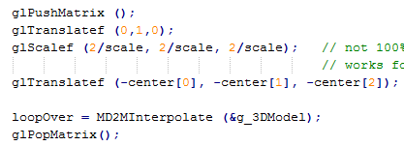
scale = max (size[0],size[1],size[2]);
glScalef (2/scale, 2/scale, 2/scale);
glTranslatef (0,1,0);
glTranslatef
(-center[0], -center[1], -center[2]);

Slide 9
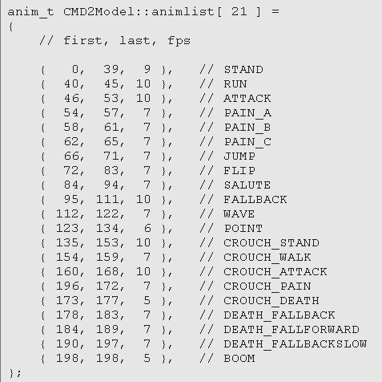
Typical MD2 Poses
May not have all of them
void MD2MSetAnimation
  (t3DModel*, int pose);
  Pose starts from 0
void MD2MSetAnimationSpeed
  (t3DModel*, float Hz);
  Time between two consecutive frames is (1/Hz) seconds

Slide 10
Data Structure of t3DModel
t3DModel
Int | kAnimationSpeed (Hz) | Time between 2 consecutive frames is 1/Hz sec.
DWORD | lastTime (msec) | The first recorded timestamp of this frame
Int | currentAnim | Current pose
Int | currentFrame | Which frame in the current pose

Slide 11
Interpolation
tAnimationInfo
Char | Name
Int | startFrame
Int | endFrame
Logic:
currentFrame = startFrame
nextFrame = (currentFrame+1)%endFrame
If (nextFrame ==0) nextFrame = startFrame

Slide 12
Interpolation Details
Called within display routine
currentAnim from frame 11 to 14
10
11
12
13
14
T (=1/Hz)
f≈Δt/T
Δt
lastTime
lastTime: the time stamp when the currentFrame starts (msec)
Measure Δt since lastTime
If Δt < 1/Hz
return a fraction [0,1) to interpolate the geometry between the (current & next) frames

Slide 13
If Δt exceeds 1/Hz,
set currentFrame to nextFrame; update lastTime; Set geometry to currentFrame
10
11
12
13
14
T (=1/Hz)
Δt
lastTime
Assumption: Δt wont be too big so fast that advancing one frame is enough!
10
11
12
13
14
T (=1/Hz)
lastTime

Slide 14
For slower machine …
NOT YET
10
11
12
13
14
T (=1/Hz)
f≈Δt/T
Δt
lastTime
Need to determine how many T’s passed and jump to that frame …
Fraction becomes irrelevant (just display the frame)

